Slide 1
Rating-Web Website
Final presentation
Prepared by group 8
Team leader: Seyit Ahmet Inci
Team members:
Sinem imge Turgut.
Abraham Henry Atogwe.
Khawlah Alshubati

Slide 2
Review:
Introduction
Project planning and management
Risk analysis/CPM/pert
Cocomo Model
Project Diagrams
Standards Applied/ Ethics
Functional Requirements/ User Interface
Non-Functional Requirements
Conclusion.

Slide 3
RatingWeb
The aim of the WebRating System is to help users identify the genuineness of the websites they are using and to know which website is better by the opinion of other users.
1

Slide 4
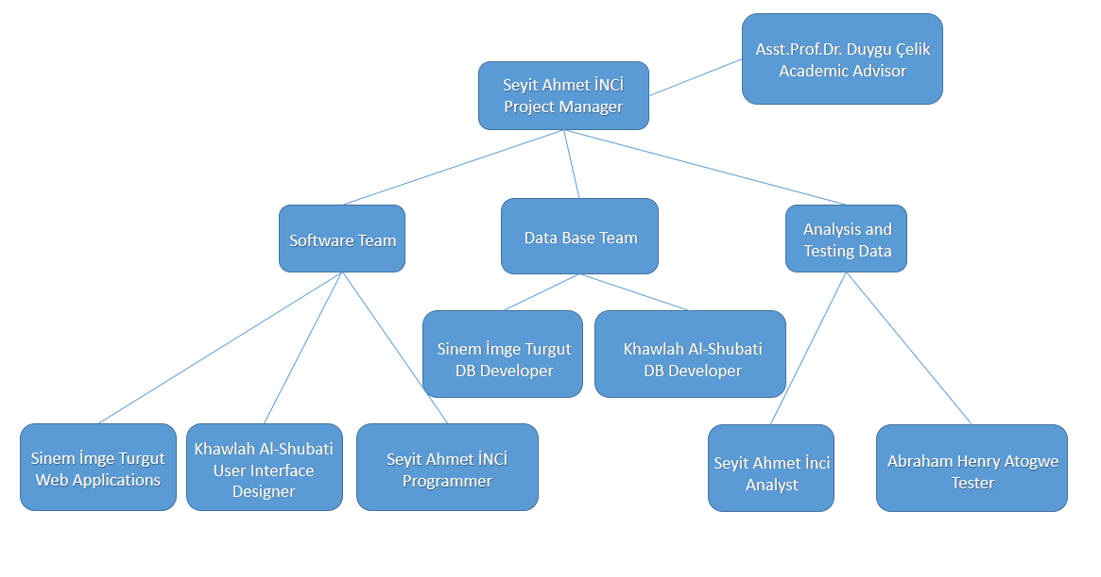
Project team responsibilities:

Slide 5
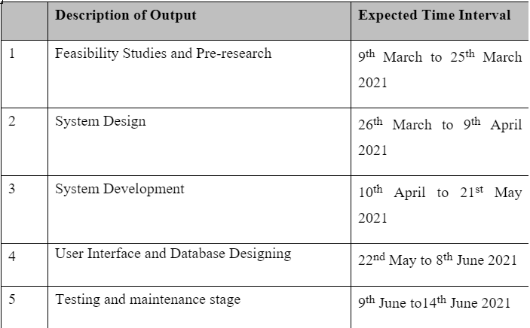
Project management:
Project Definition
Aim of the Project
Scope of the project
Target Users/Innovative Aspects/Contributions of Project
Tools/Methods applied
Reasons for starting the Project

Slide 6
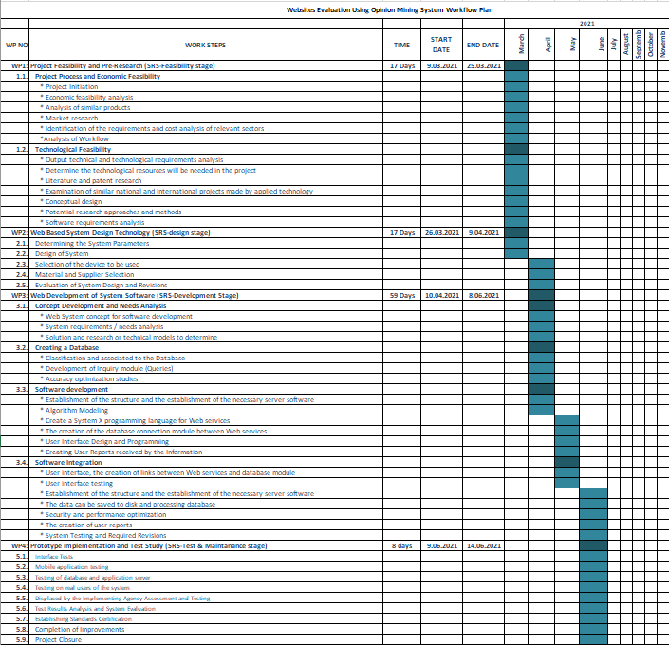
Gantt Chart

Slide 7
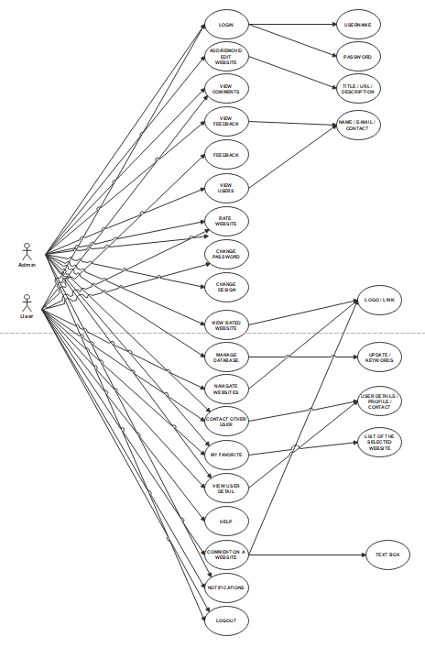
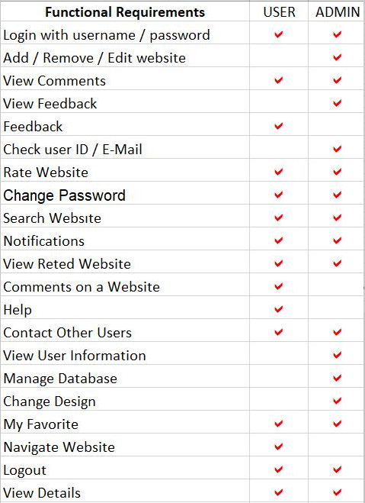
Use Case Diagram:

Slide 8
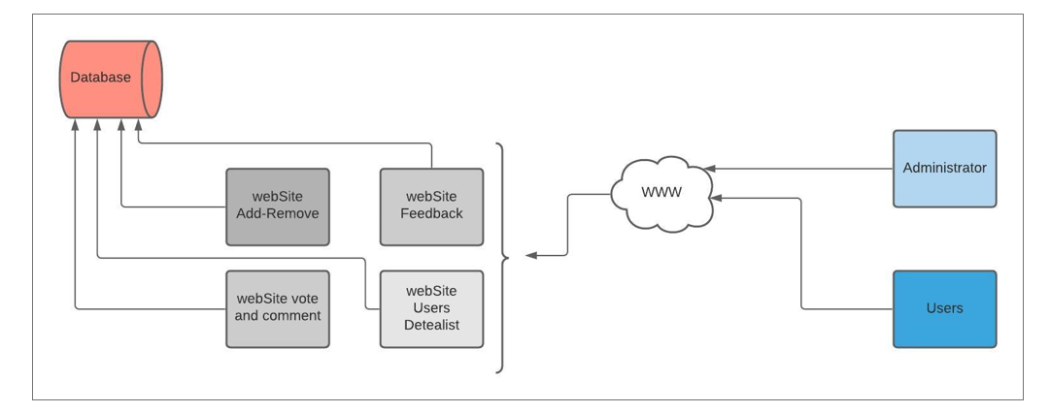
Architectural Diagram:
6

Slide 9
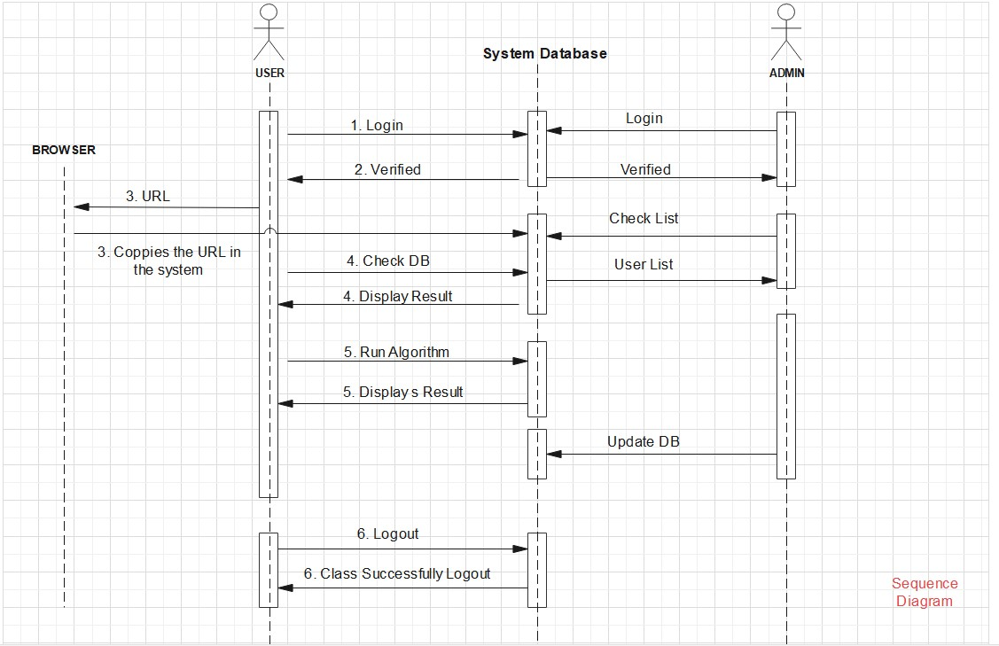
Sequence Diagram:

Slide 10
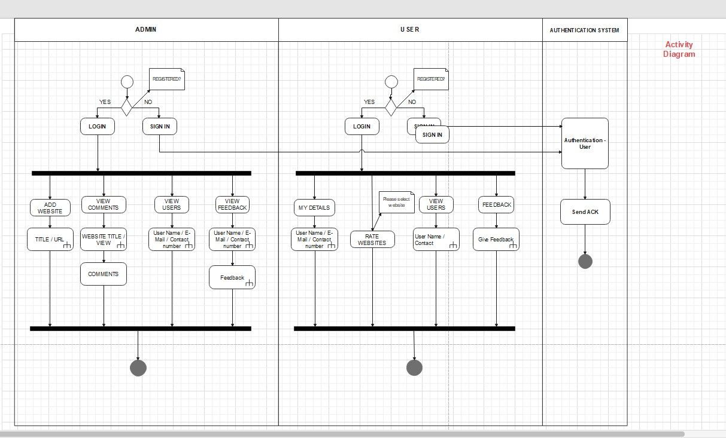
Activity Diagram:

Slide 11
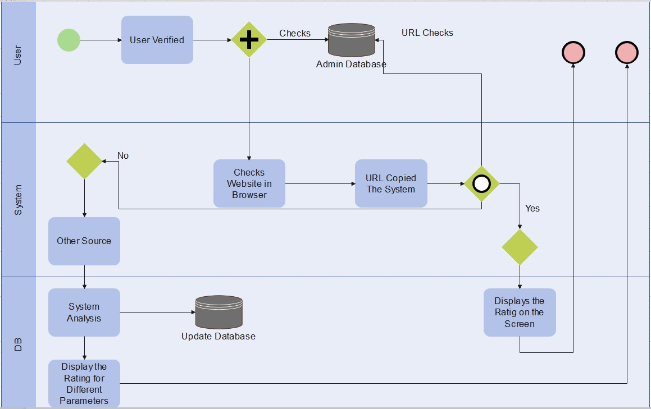
BPMN Diagram:

Slide 12
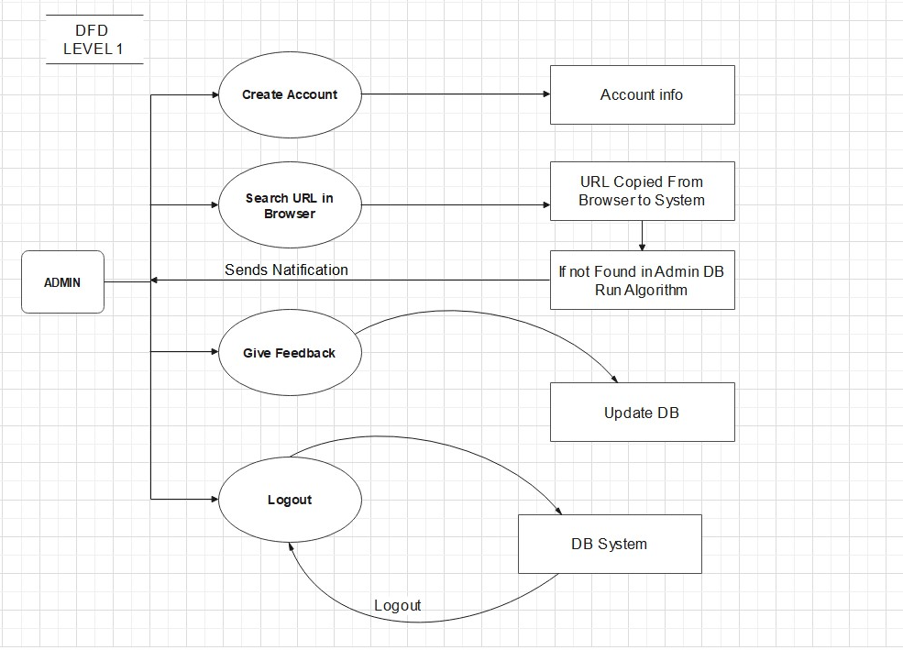
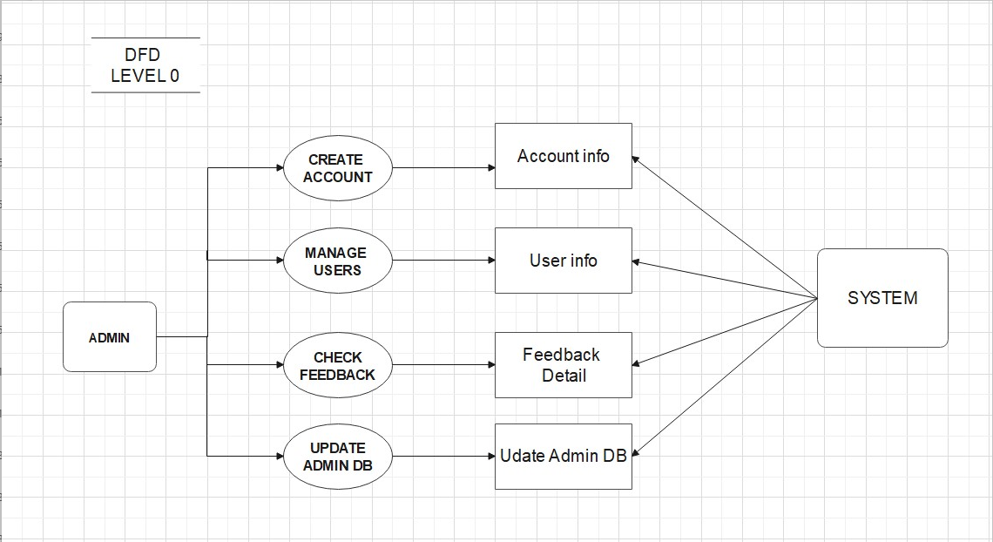
Data-Flow Diagrams:

Slide 13
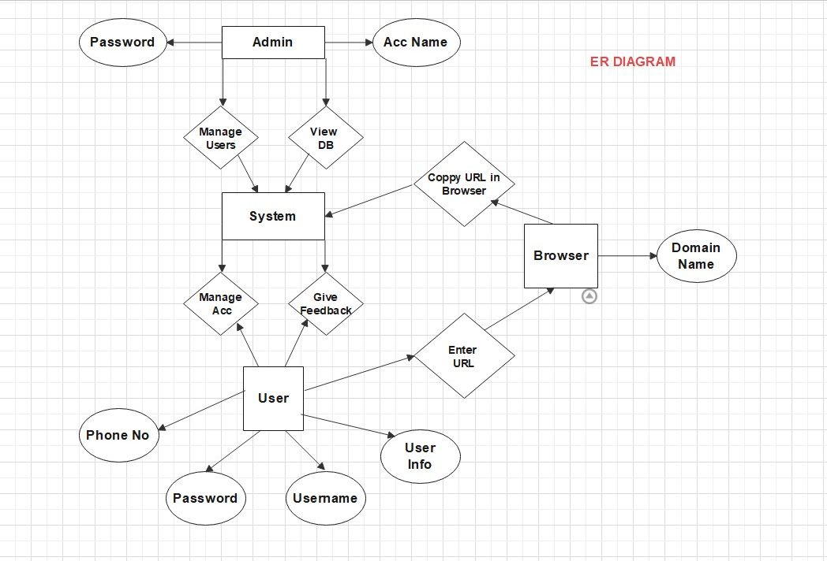
ER Diagram:

Slide 14
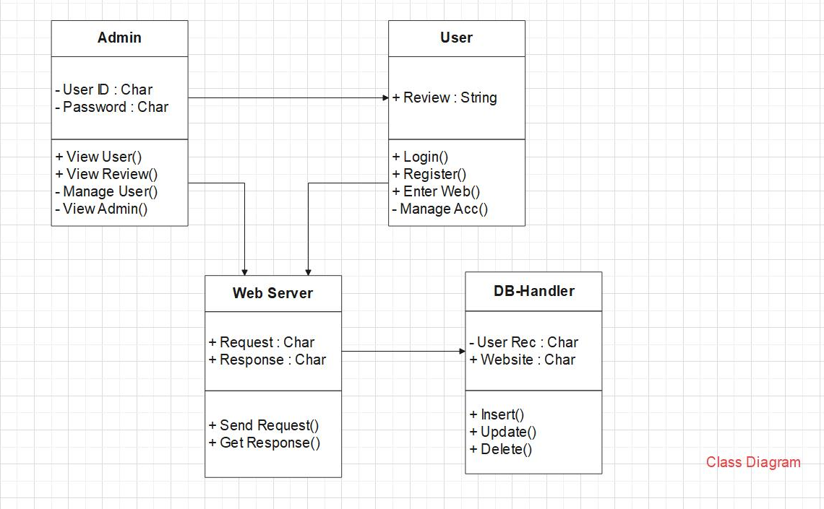
Class Diagram:
5

Slide 15
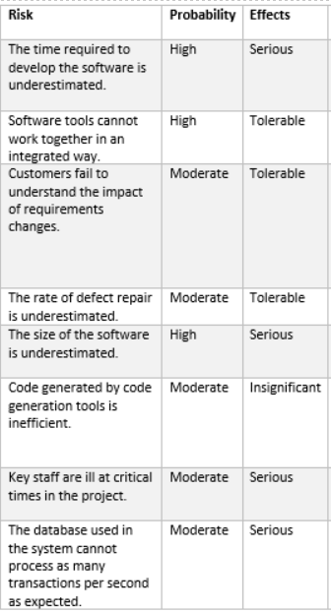
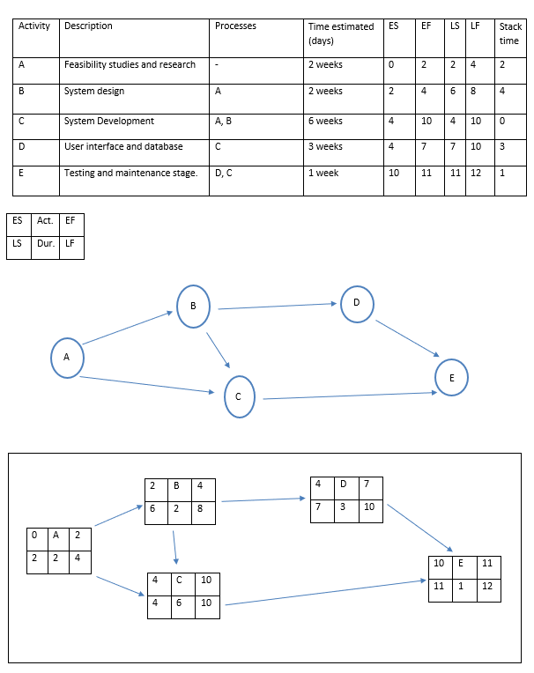
Risk Analysis:
CPM using Pert

Slide 16
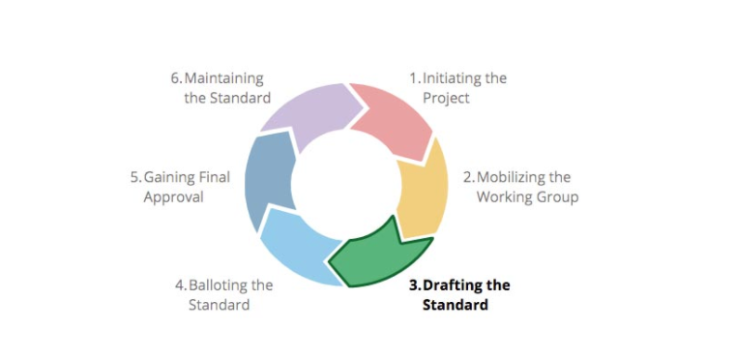
Standards Applied:
IEEE Standards

Slide 17
Project Ethics:
website acts consistently with the public interest
ensures that their products and related modifications meet the highest professional standards possible.
managers and leaders shall subscribe to and promote an ethical approach to the management of software development and maintenance.
the users’ must be honest when writing their comments on a website according to their experience.
Users’ information should be kept confidential in the database.
There should be no offense for other users in the system.
4

Slide 18
Functional Requirements:
The user should be able to navigate between the tabs of different websites.
The user should be able to login and logout of the system.
The user should have either used the website before or is looking to use a certain website.
The user should be able to navigate between the tabs of different websites.
The user should be able to login and logout of the system.
The user should have either used the website before or is looking to use a certain website.
The user needs to be honest and biased when giving his opinion.
The admin should have to be in contact with the website’s owner.
The admin needs to be aware of all new created websites so as to add them to the system to be rated.
The admin should be able to add and describe the website.
The admin should focus more on the websites that prompts the user to transfer money or do
payments since such websites have the biggest priority for rating.
9

Slide 19
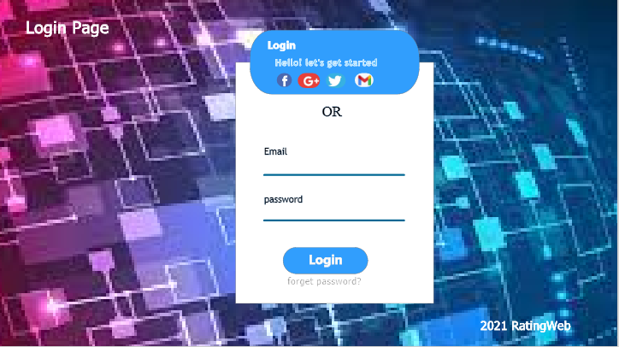
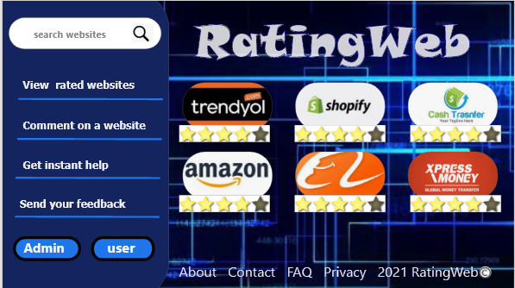
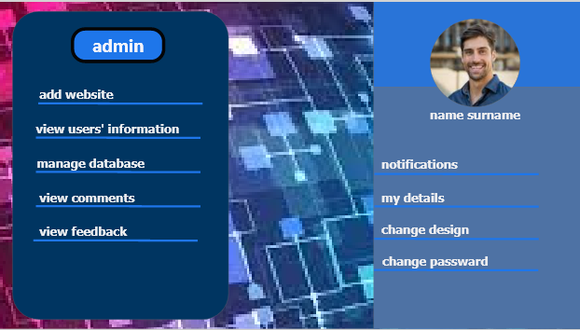
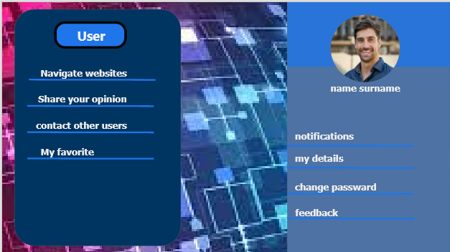
User Interface:
11

Slide 20
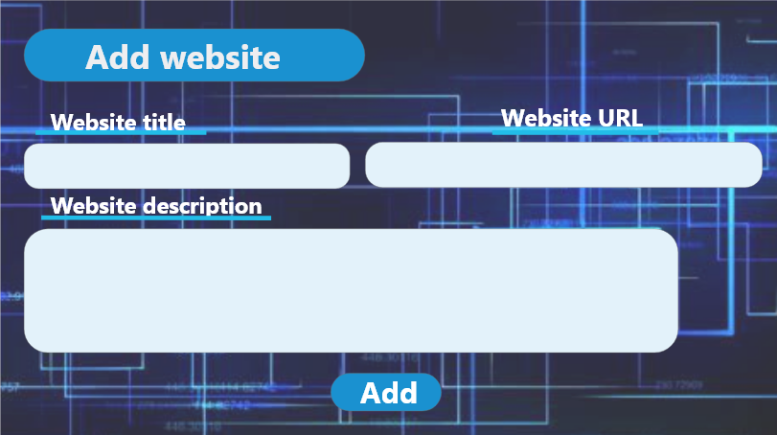
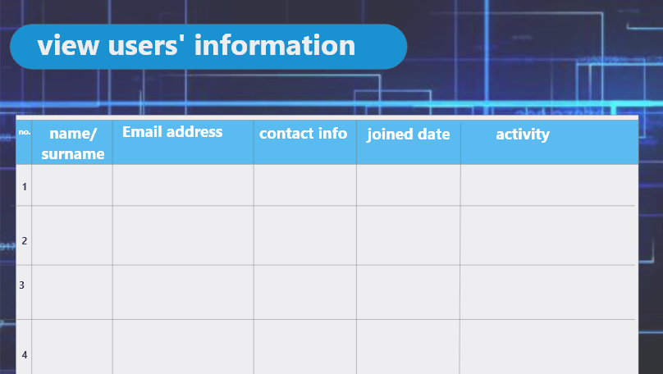
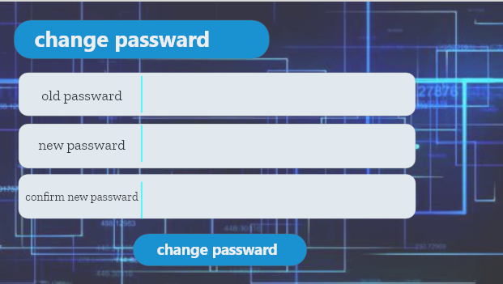
User interface:
12

Slide 21
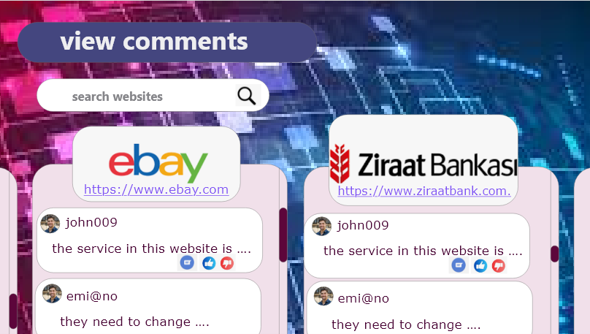
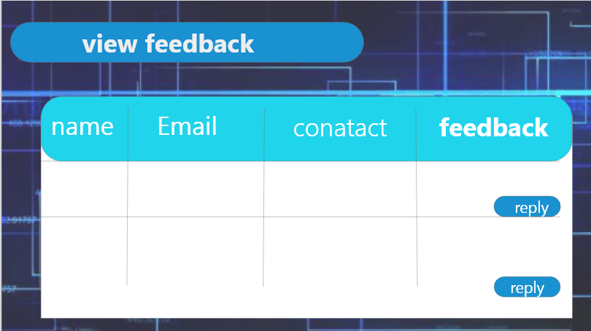
User Interface:

Slide 22
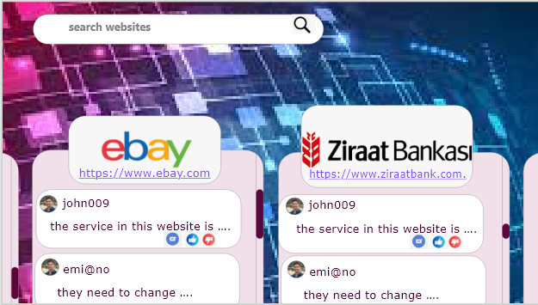
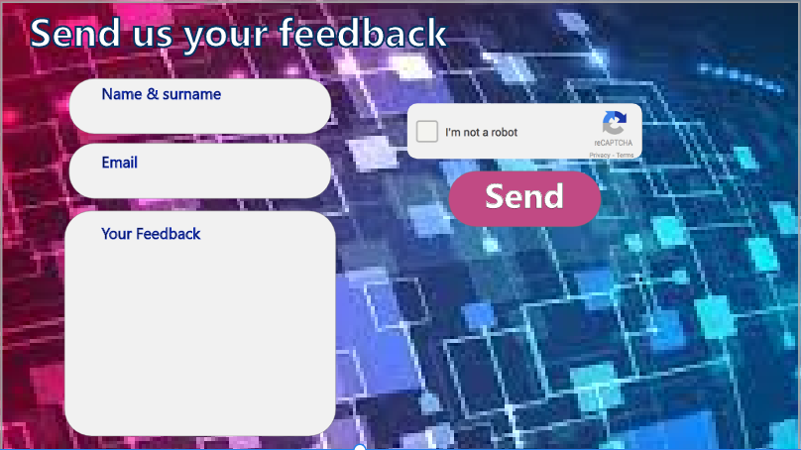
User Interface:

Slide 23
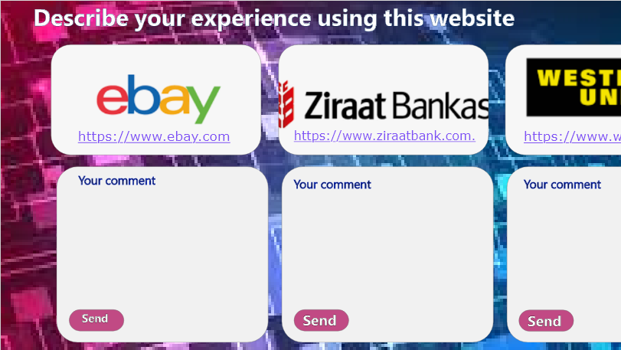
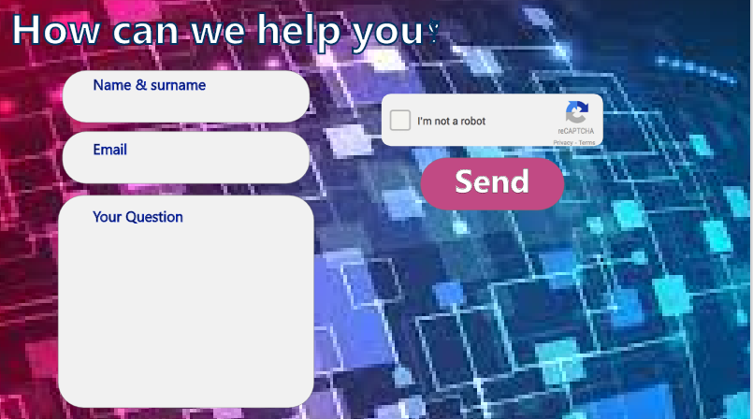
User Interface:
10

Slide 24
Nonfunctional Requirements:
1. Reliability:
The system should be available when requested for service by users: The system should work 24/7, it should always be up and running so that whenever the user wants to use it, it is available.
The system should have a very low failure rate: The failure rate should be kept as minimal as possible, preferably less than 0.01

Slide 25
Nonfunctional Requirements:
2. Performance Requirements:
The system must have a good response time.
The load time for the User interface should take less than two seconds.
It should be able to respond to multiple numbers of people at the same time.
The log in information should be verified within five seconds.
Queries shall return results within five seconds.
The system should be able to achieve a lot in a specified amount of time.
17

Slide 26
Nonfunctional Requirements:
3. Security Requirements:
All external communications between the system’s data server and users’s must be encrypted by Hasting. Hashing is a one-way function where a unique message digest is generated from an input file or a string of text. No keys are used
To ensure that the system is secure, access to the various subsystems will be protected by a User log in screen and requires a User information (Mail, Name, Pass-word).
To avoid loss of data in case of system failure, all system data must be backup every 24 hours and the backup copies stored in secure location different from the system. The system data should be stored in storage device e.g. hard drive, CD, Flash drive(USB) or it could be stored in files.
19

Slide 27
Nonfunctional Requirements:
4. Usability:
The system should have a well formed, easy and soft to use graphical User interface.
The system should be User friendly.
The system must be easy to learn for both novices and Users with experience from similar systems.
The User must understand what the system does.
The User must feel satisfied with the system.
The system must be easy to remember for the casual user.
The user must feel satisfied with the system

Slide 28
Nonfunctional Requirements:
5. Safety Requirements:
The system should maintain a good backup: Maintaining backups ensures that the system’s database is secure, which means that in case of an emergency or accident the system can be easily restored.
18

Slide 29
Nonfunctional Requirements:
6. Maintainability:
The system should be easy to maintain.
In order for the system to be easy to maintain it is done with a web-based, which is easy to maintain and which are Visual Studio and SQL.
Maintenance of the system should be cost efficient
Maintenance of the system should be less frequent.
The system should easily adapt to changes made

Slide 30
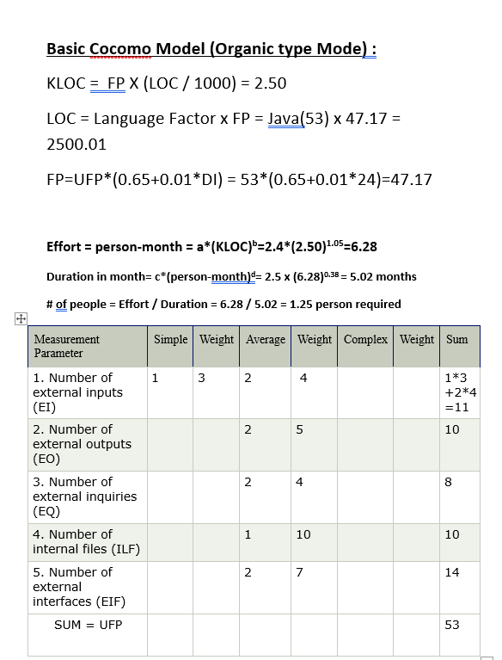
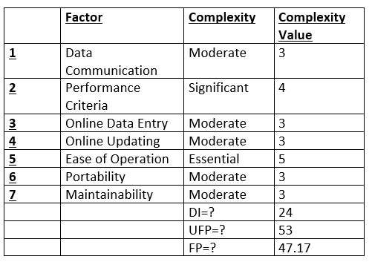
Cocomo model:

Slide 31
The Conclusion

Slide 32
Thank you

